Slide 1
CAPSTONE PROJECT
Movie rental analysis

Slide 2
PUBLICATION
This analyzes customer behavior and sales performance in a movie rental business using real transactional data. Key insights reveal popular film categories among customers, identify high-value customers based on rental spending, and uncover peak rental days by store location. Additionally, the study evaluates inventory utilization and rental durations to understand demand patterns. These findings offer actionable strategies for optimizing inventory, targeting promotions, and improving customer engagement—ultimately driving more efficient operations and informed decision-making in the movie rental industry.
Customer & Sales Analysis
This segment are focuses on analyzing film inventory usage and genre performance within a movie rental business. The study highlights the most demanded film categories by customers and examines how inventory availability affects overall rental revenue. Patterns in inventory turnover and usage reveal optimal stock levels and underperforming titles. These insights assist in making data-driven decisions for inventory planning, maximizing rental potential, and aligning film offerings with customer preferences.
Inventory & Film Analysis

Slide 3
This section analyzes the impact of store operations and staff performance on rental activity. It explores variations in rental volumes across store locations and identifies the busiest rental days for each branch. The analysis also evaluates staff effectiveness in driving customer engagement and sales. Key findings highlight operational strengths and opportunities for improving store-level strategies, ensuring consistent customer service, and optimizing staff allocation to enhance business efficiency.
Staff & Store Analysis
This section focuses on understanding customer behavior based on demographic attributes such as first name (used as a proxy for identity), rental patterns, and spending behavior. The analysis identifies top-spending customers and their contribution to overall revenue, offering insights into high-value customer segments. These findings help in tailoring marketing strategies and enhancing customer retention by focusing on key demographics that drive the most sales and engagement in movie rentals.
Demographic Analysis
The category analysis reveals trends in genre preferences and their correlation with rental frequency and revenue contribution. By examining rental counts across different film categories, the study identifies the most in-demand genres such as Action, Sports, and Sci-Fi. This insight is critical for inventory planning and marketing focus, allowing the business to prioritize content that aligns with customer preferences and maximizes profitability.
Categories Analysis

Slide 4



OBJECTIVE: To analyze customer behavior, film preferences, and operational performance using transactional and demographic data from a movie rental firm, with the goal of uncovering data-driven insights that improve customer retention, optimize inventory, and drive revenue growth.
ANALYTICS SCOPE: This analysis covers customer segmentation, rental trends, film demand, inventory utilization, and store performance across locations. It aims to identify key drivers of revenue, popular genres, peak rental periods, and operational bottlenecks to support data-informed decisions in marketing, stocking, and staffing strategies.
GOAL: The goal of this project is to uncover actionable insights from rental, customer, and film data to optimize inventory management, improve customer retention, and enhance revenue generation through data-backed decisions in film stocking, promotions, and staffing.

Slide 5



INSIGHT & RECOMMENDATION: Repeat customers contribute the majority of rental revenue, emphasizing the value of loyalty programs. Action and Comedy films are most in demand, especially during weekends and evenings. Multilingual films and store-specific trends reveal demographic-driven preferences. Firms should optimize inventory, staffing, and marketing based on these data-backed insights.
REPORT & PRESENTATION:The report and presentation provide a concise, data-driven overview of key business areas—customer behavior, film demand, inventory trends, and store performance. Visual charts highlight rental patterns, revenue drivers, and demographic preferences. Actionable insights are tailored for operational improvements. The content is structured for clear communication with stakeholders.
POWER BI DASHBOARD: The Power BI dashboard delivers an interactive, real-time view of rental trends, customer segments, and revenue metrics. It empowers stakeholders to monitor key KPIs, identify high-performing films and stores, and make data-backed decisions. Filters and visuals enhance usability for strategic and operational insights.

Slide 6
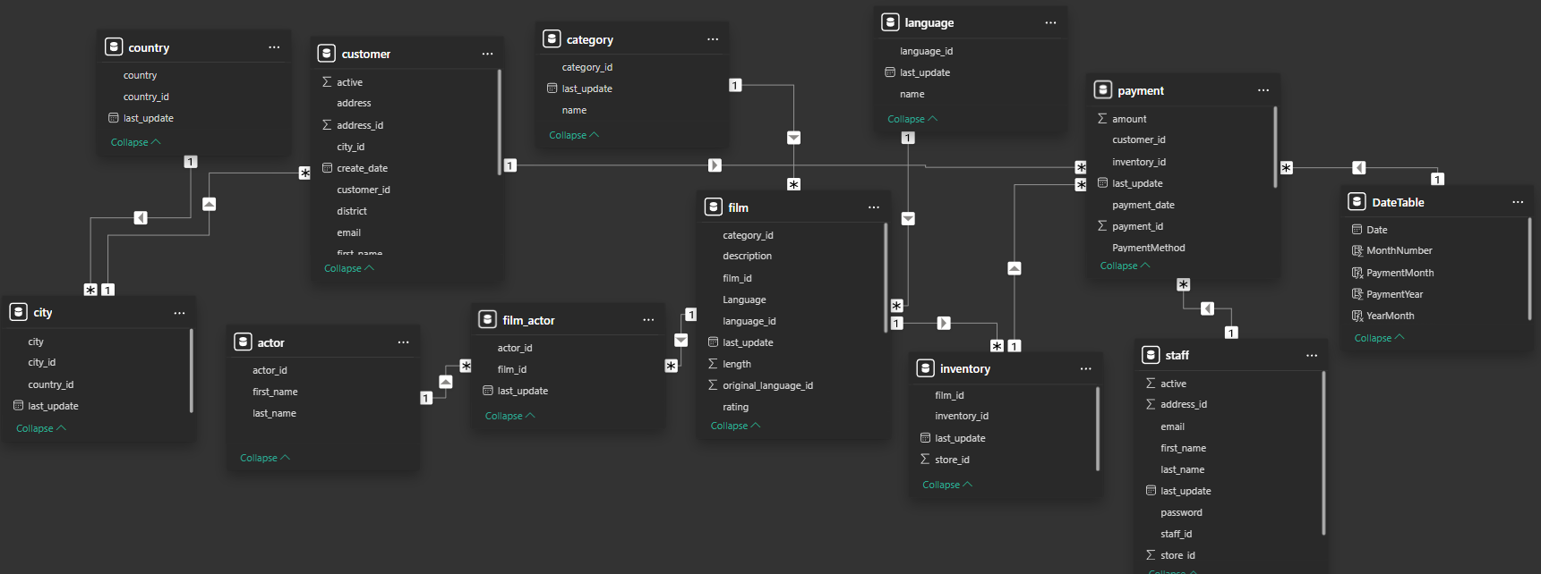
ER DIAGRAM

Slide 7
POWER BI PROBLEM STATEMENT

Slide 8
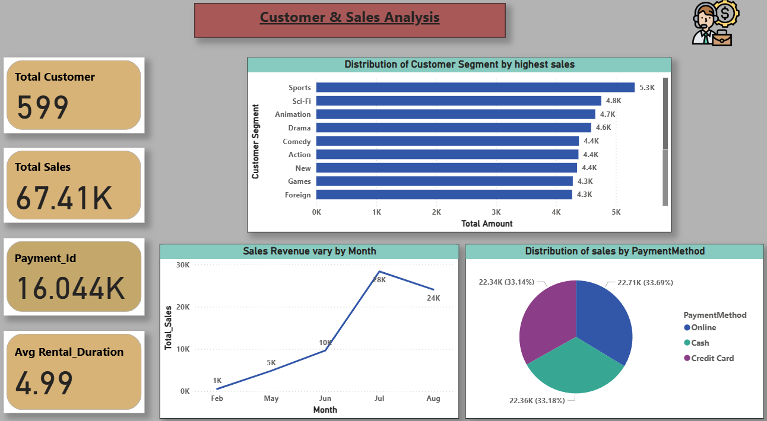

Slide 9
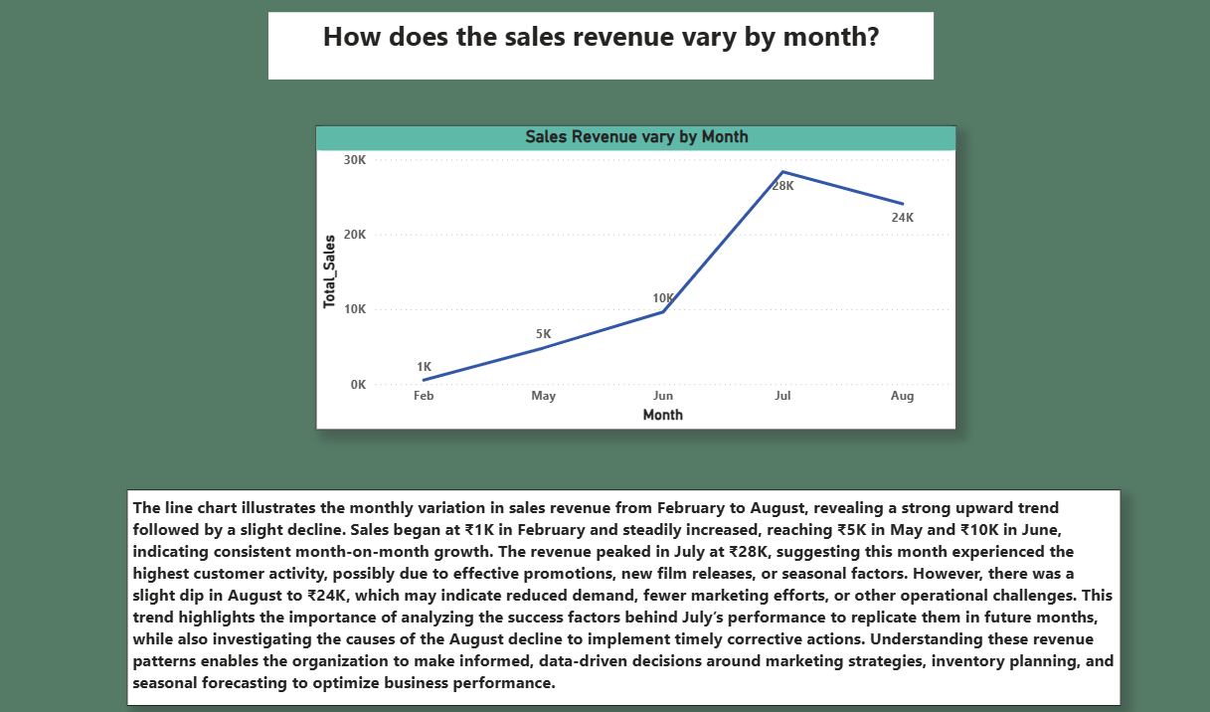

Slide 10
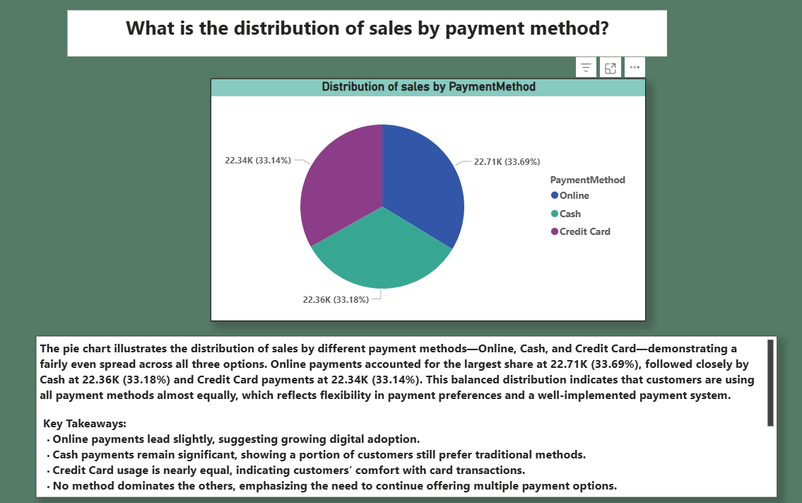

Slide 11
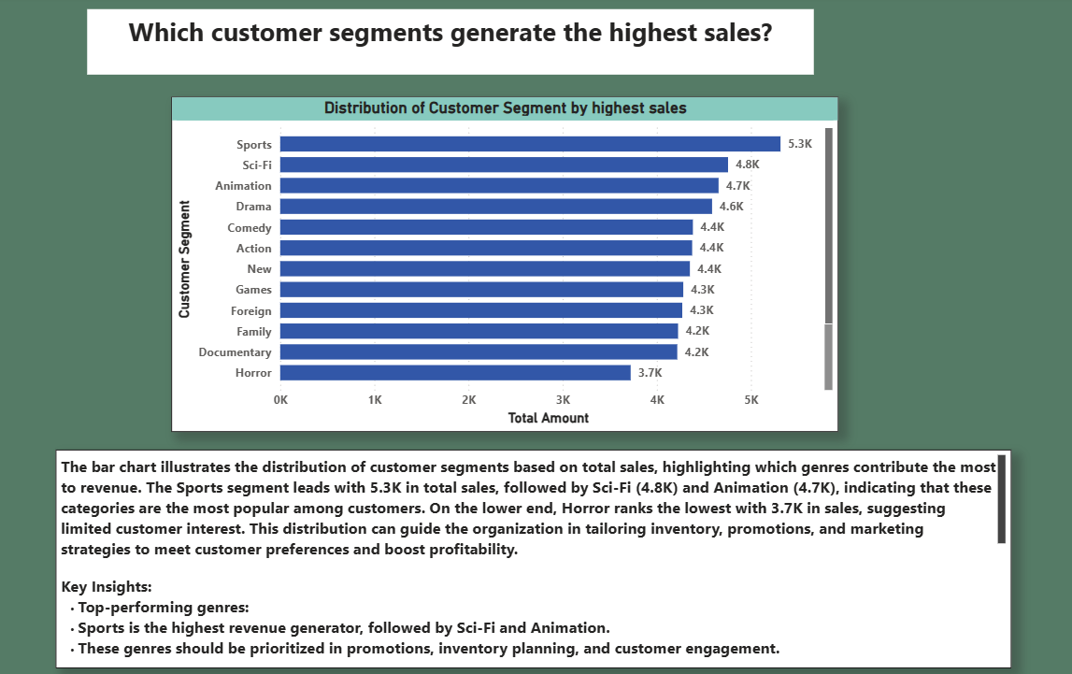

Slide 12
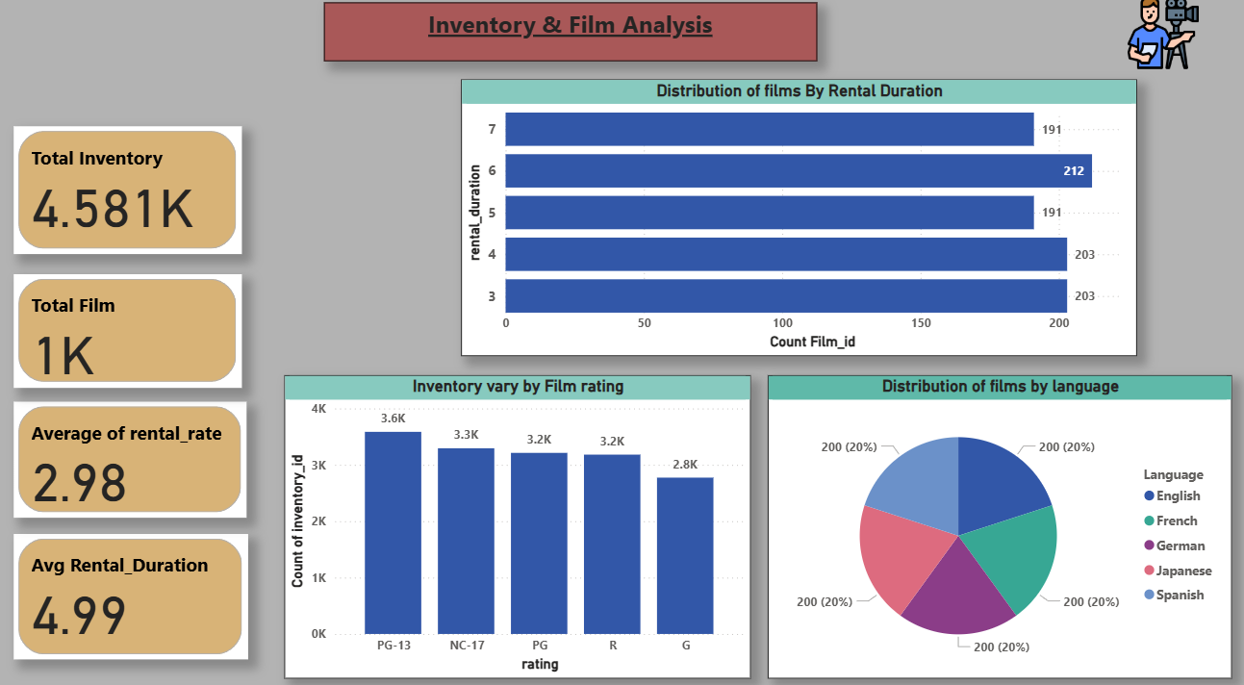

Slide 13
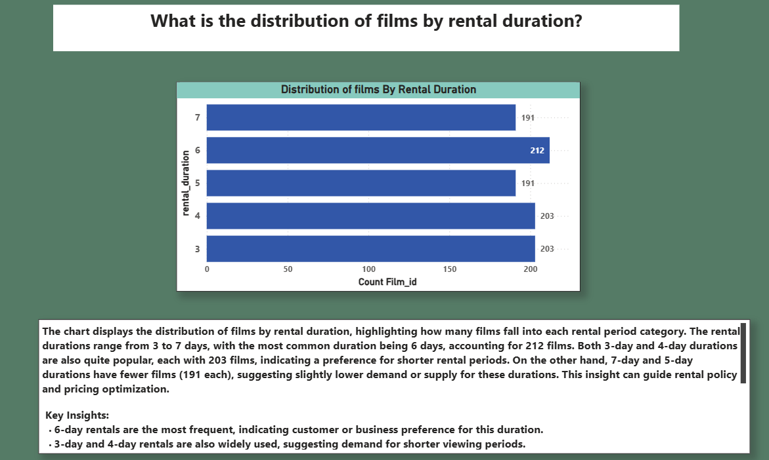

Slide 14
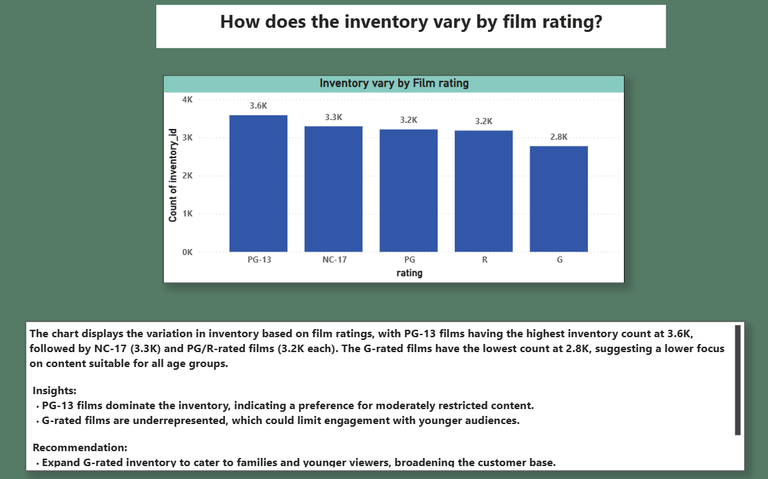

Slide 15
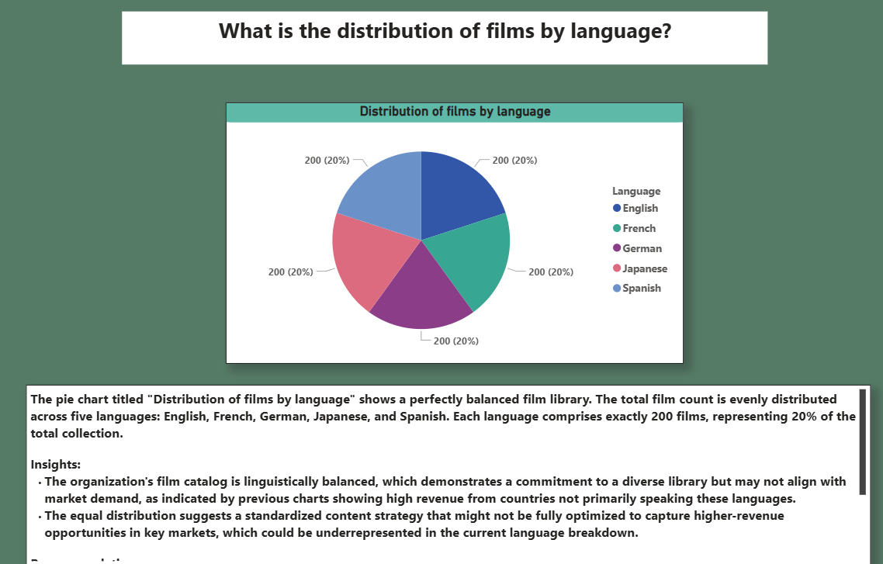

Slide 16
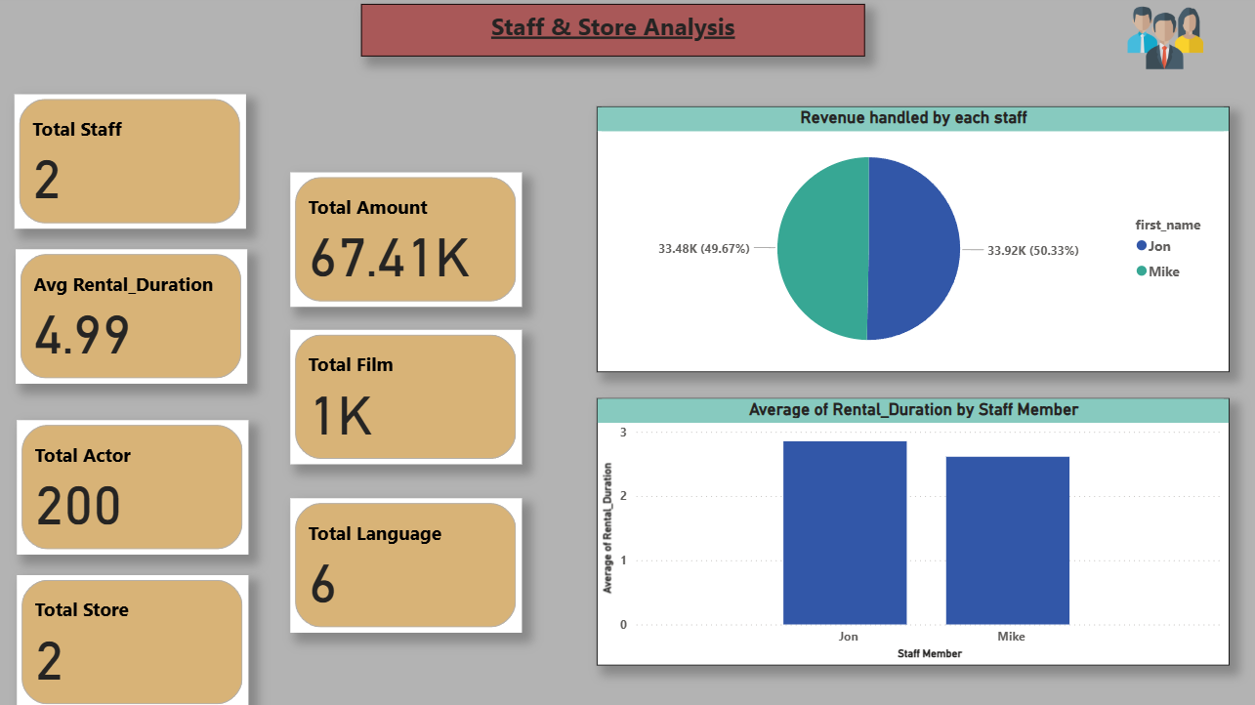

Slide 17
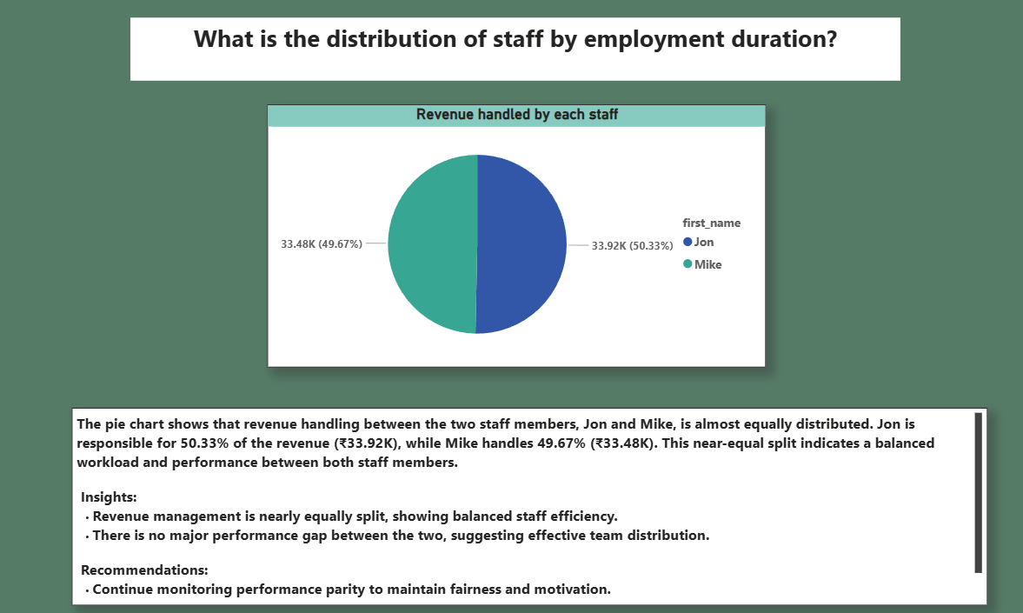

Slide 18
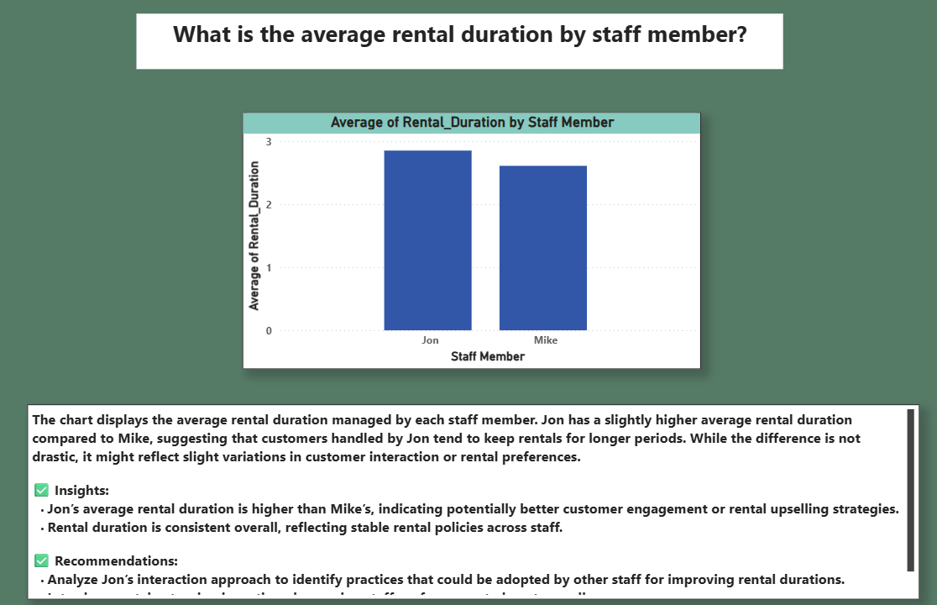

Slide 19
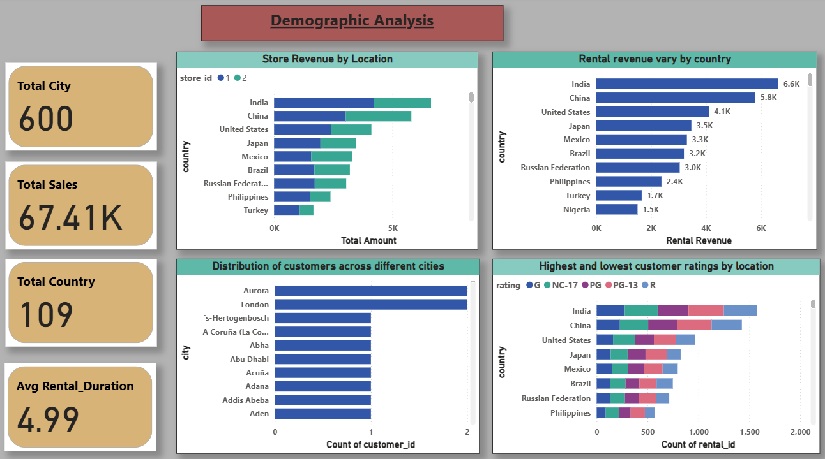

Slide 20
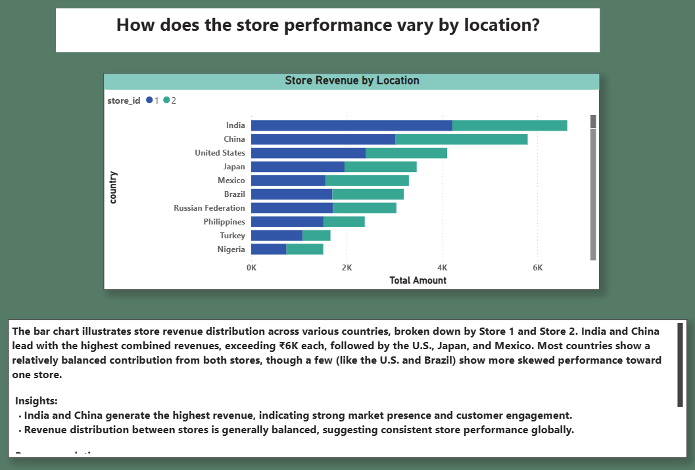

Slide 21
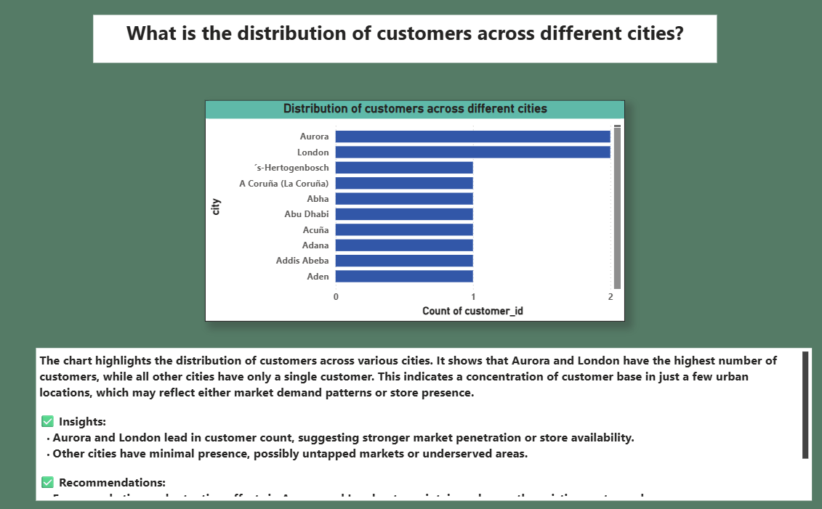

Slide 22
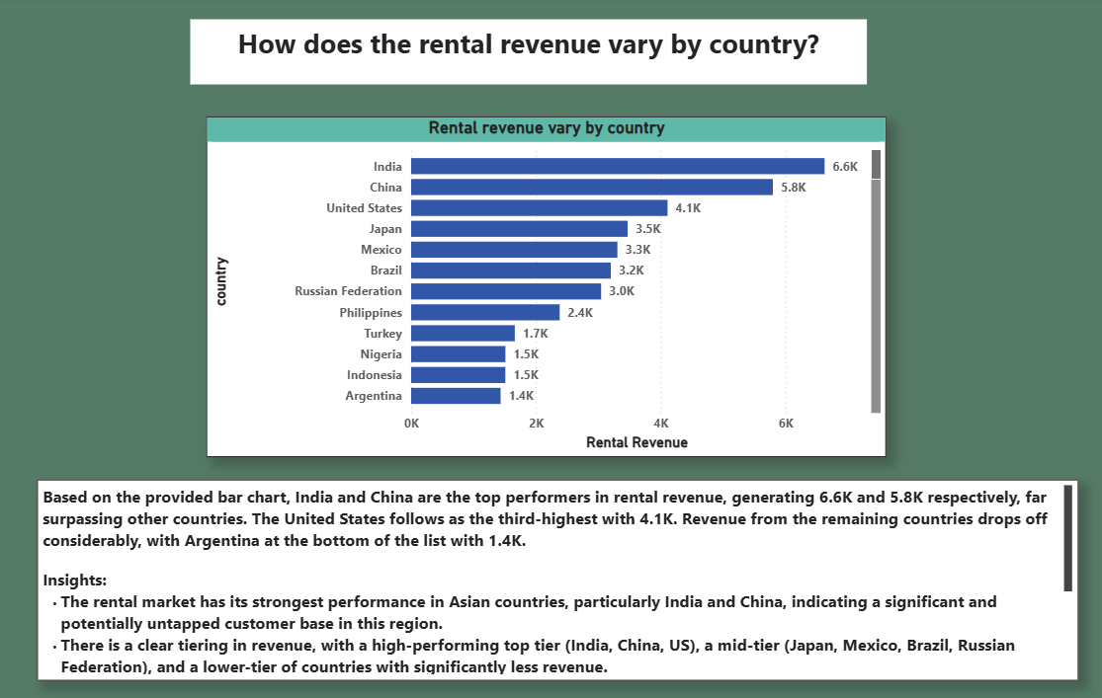

Slide 23
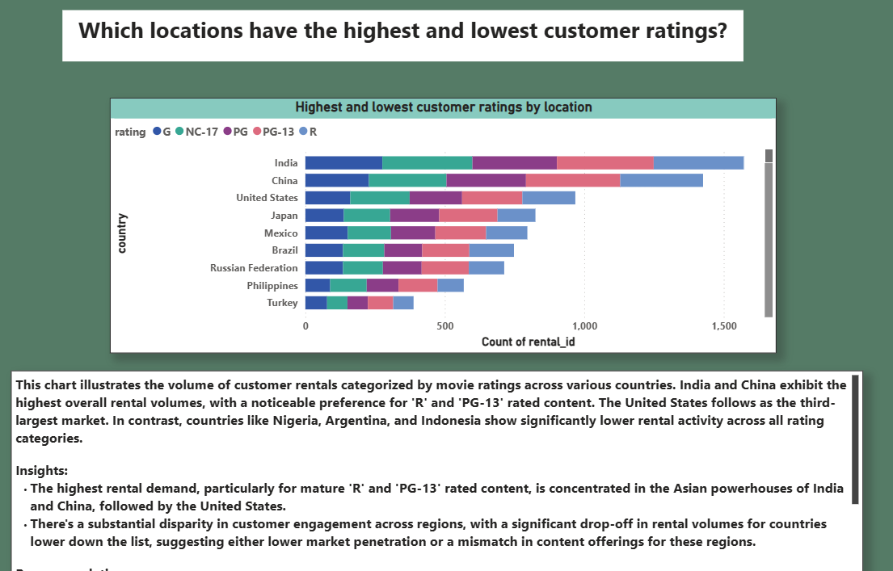

Slide 24
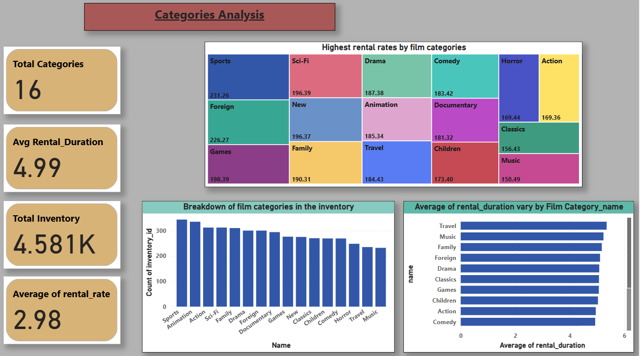

Slide 25
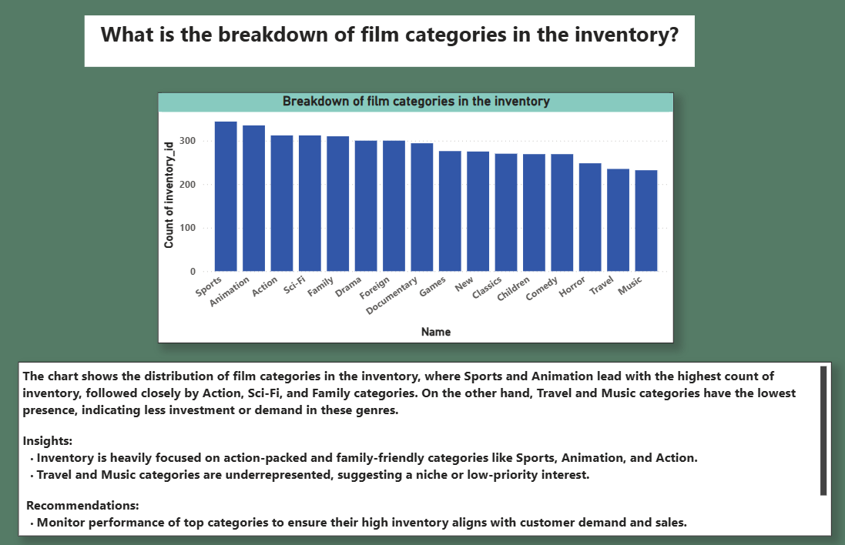

Slide 26
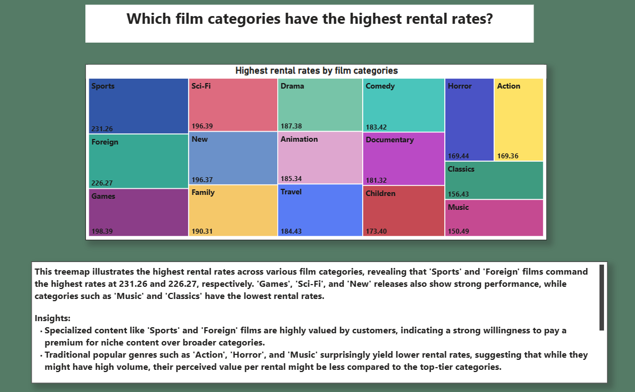

Slide 27
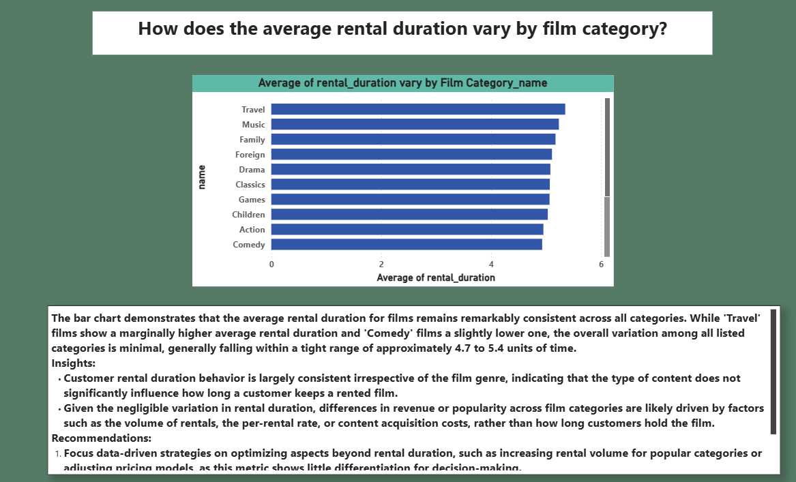

Slide 28
EDA PROBLEM STATEMENTS

Slide 29
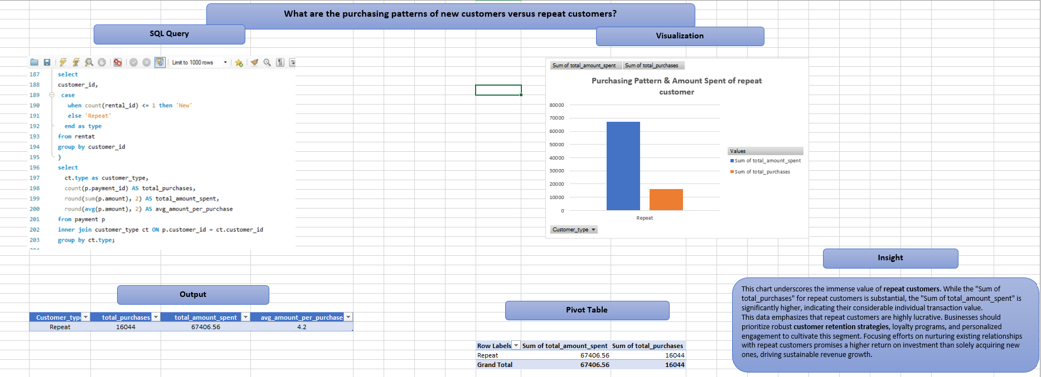

Slide 30
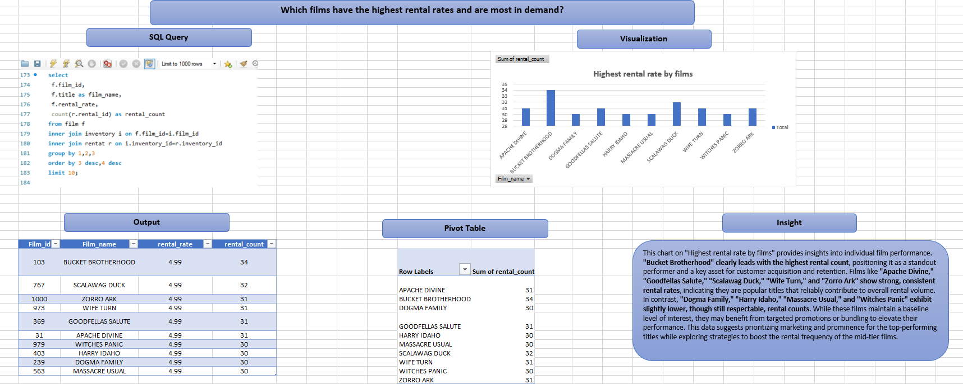

Slide 31
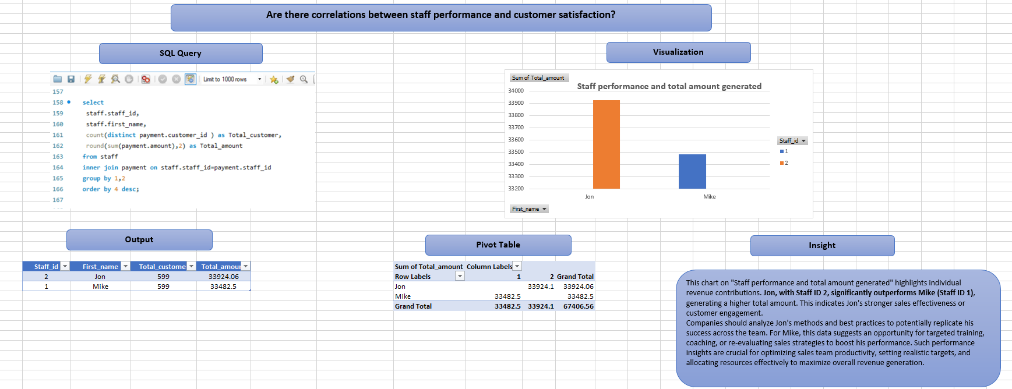

Slide 32
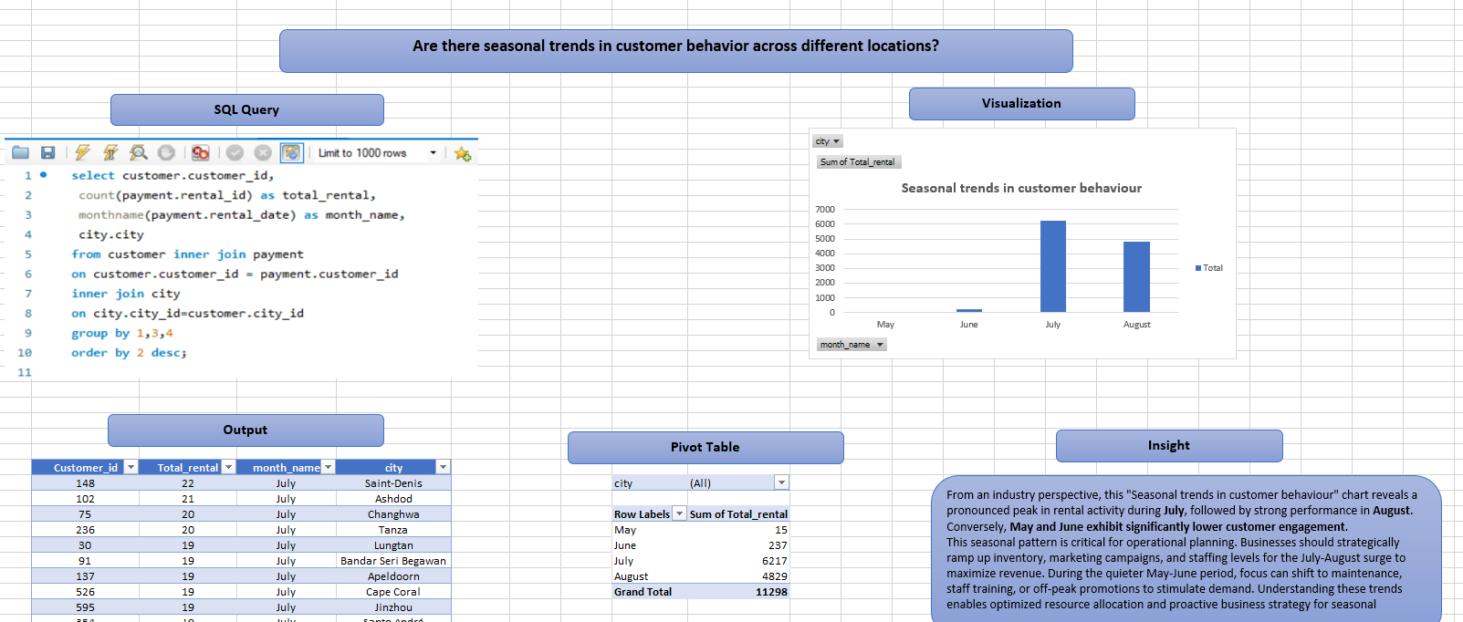

Slide 33
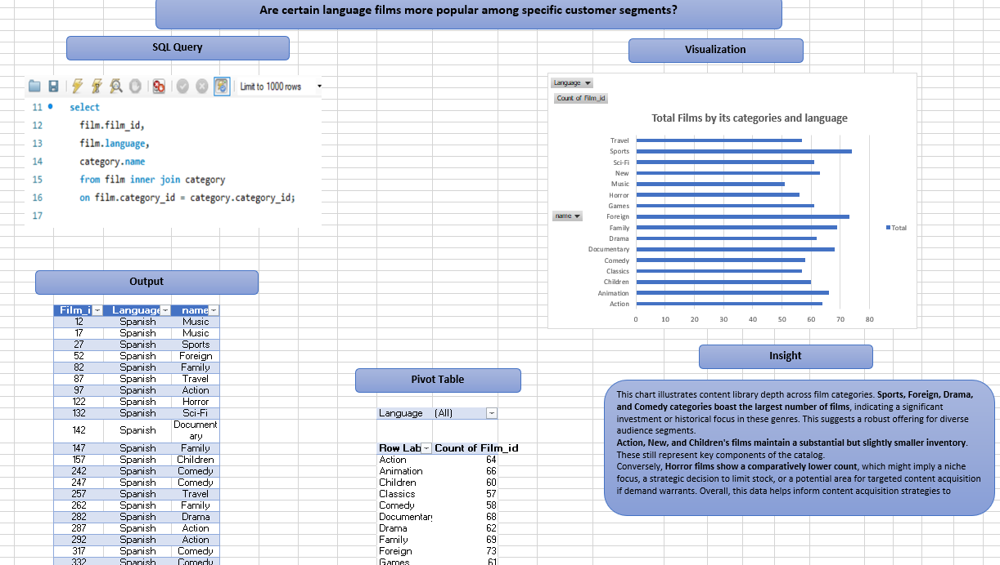

Slide 34
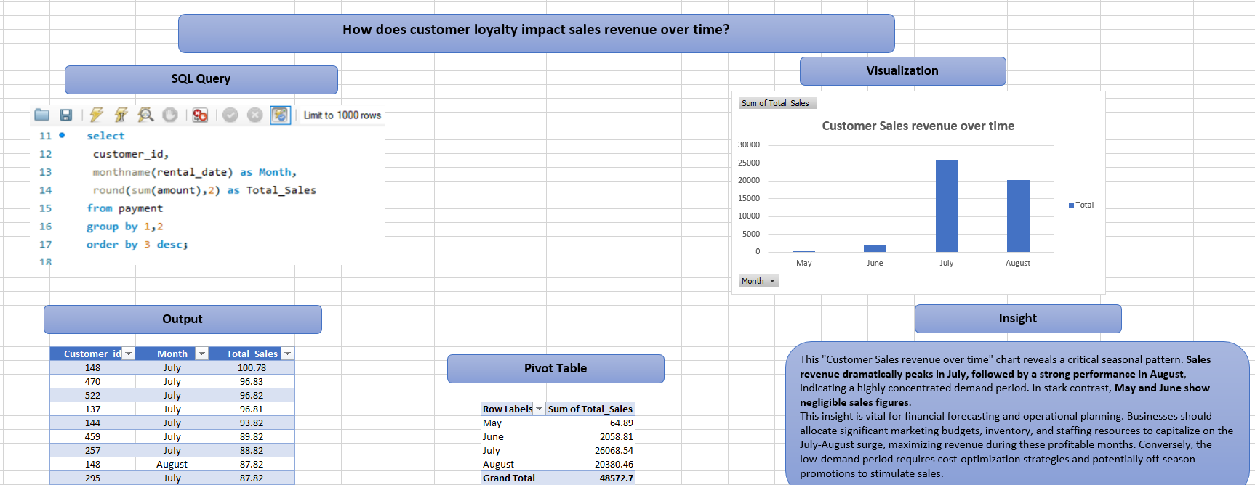

Slide 35
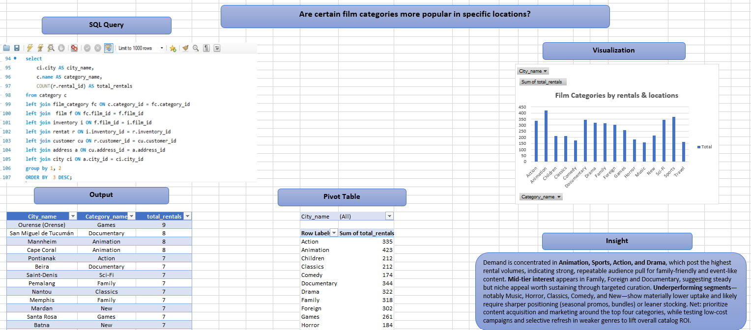

Slide 36
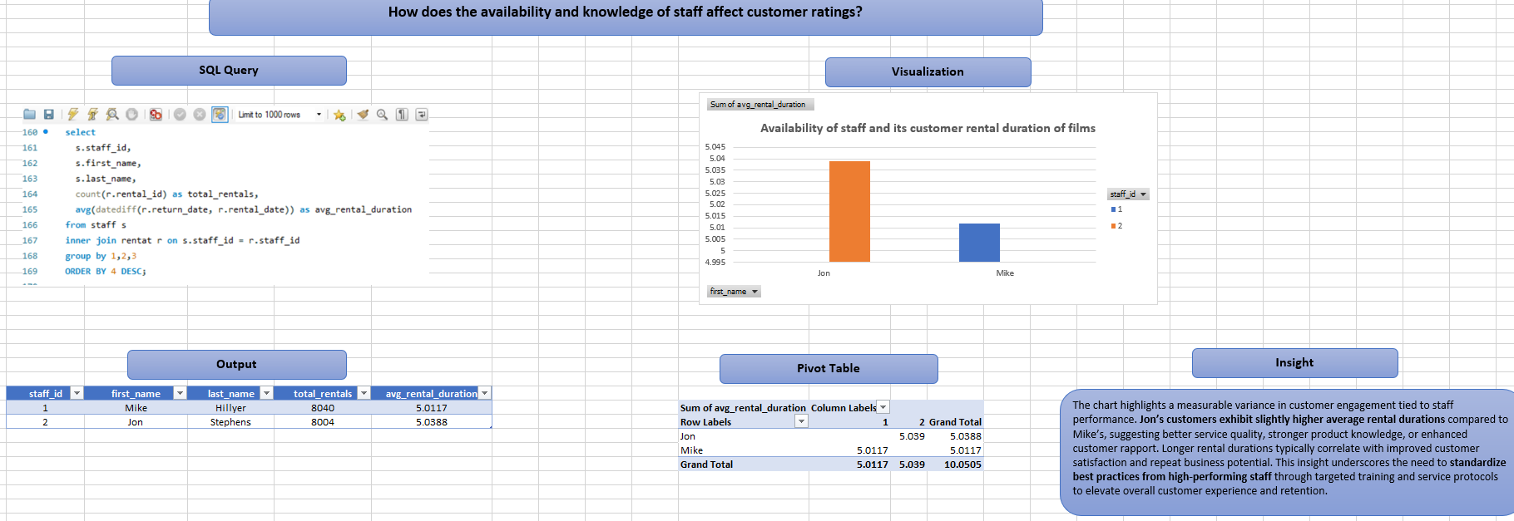

Slide 37
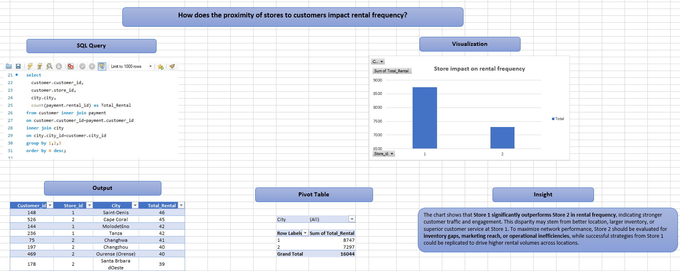

Slide 38
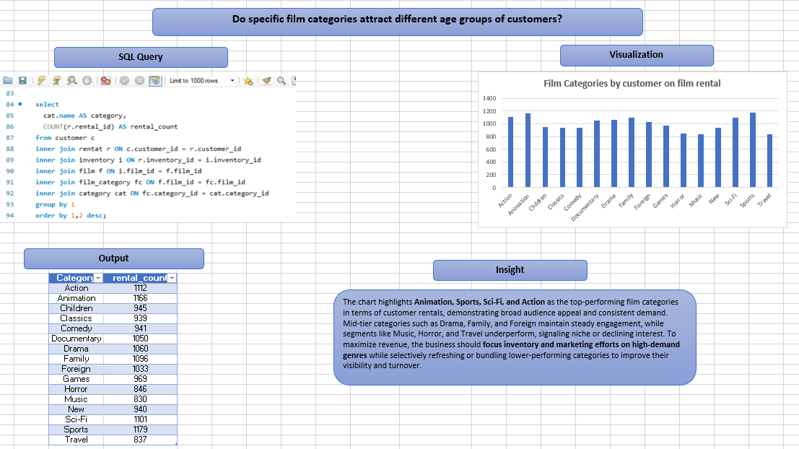

Slide 39
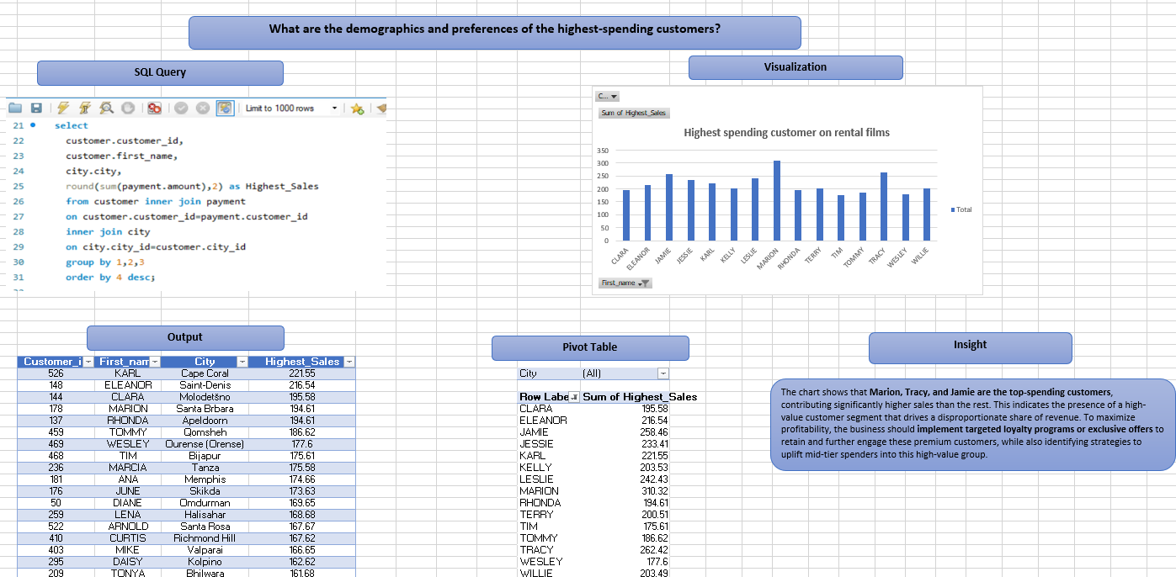

Slide 40
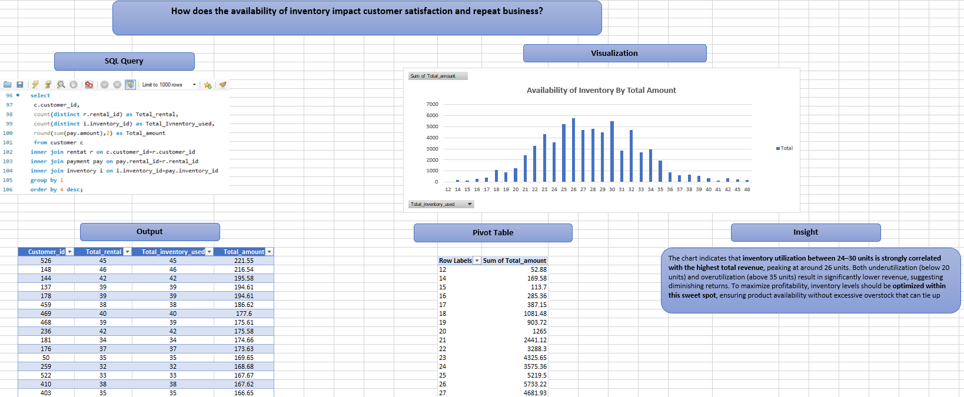

Slide 41
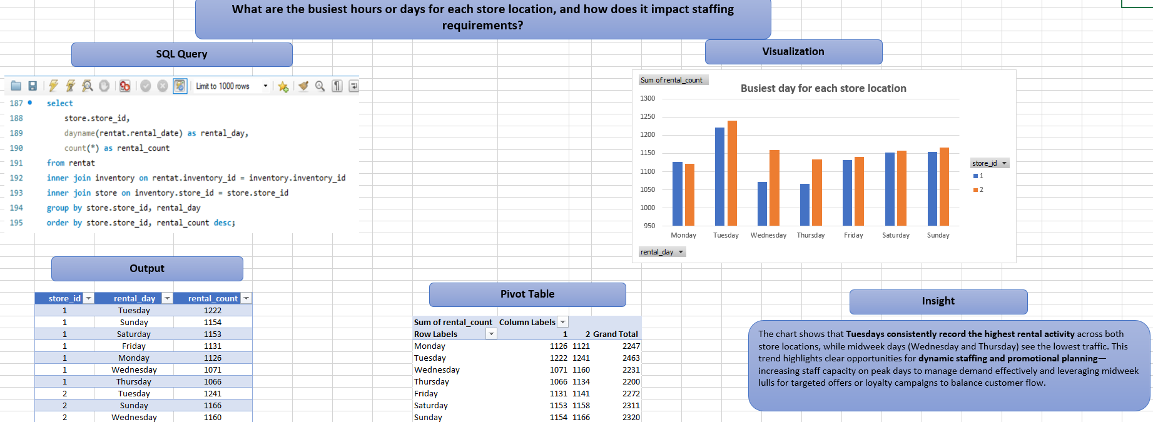

Slide 42
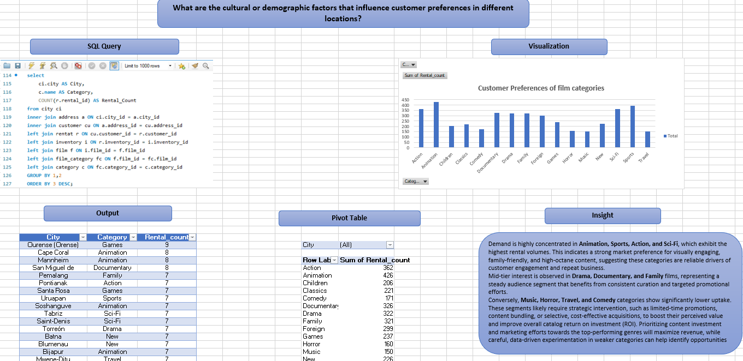

Slide 43
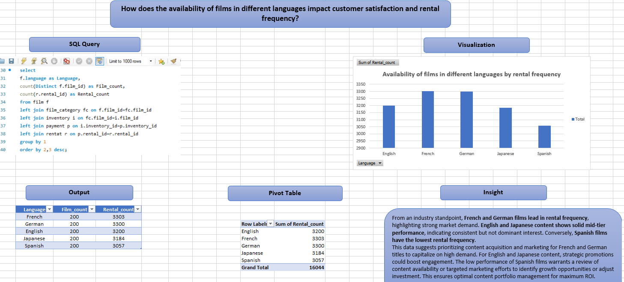

Slide 44
THANK YOU

